Slide 1
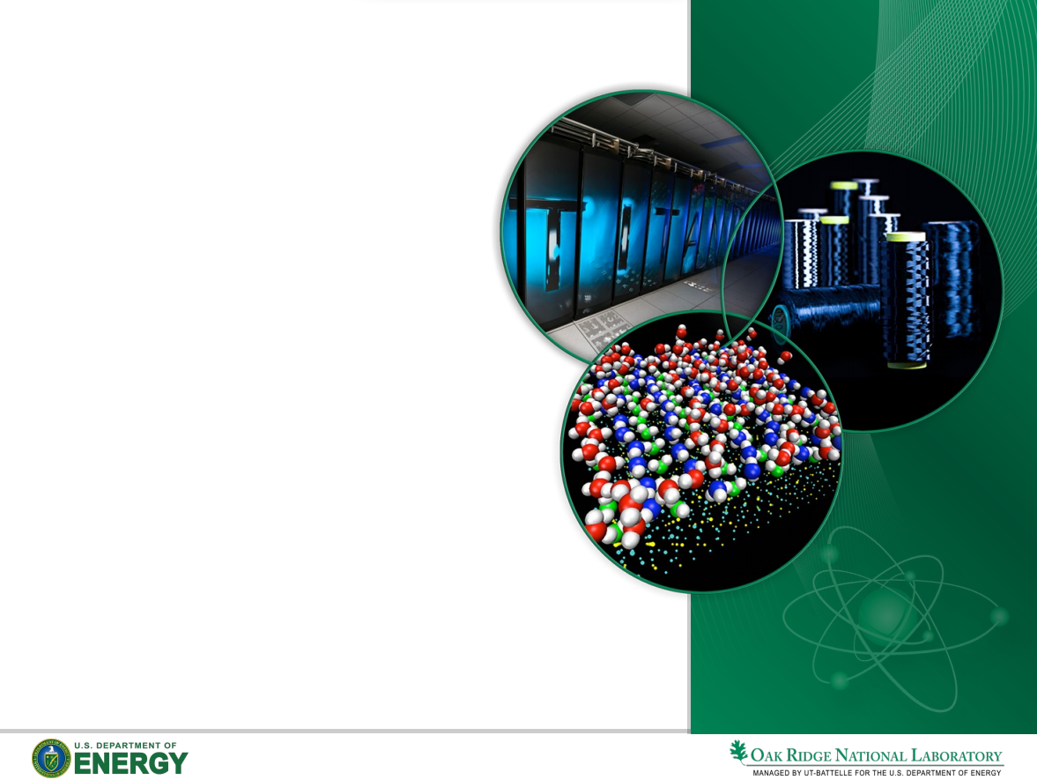
A Proposal on Workflows and the Interoperability
of Workflow Management Systems
Jay Jay Billings
Research Staff
Oak Ridge National Laboratory
The Bredesen Center - UTK
billingsjj@ornl.gov
@jayjaybillings
+jayjaybillings
20170111

Slide 2
What is a “workflow?”

Slide 3
Business Workflows
A Workflow is the automation of a business process, in whole or part, during which documents, information or tasks are passed from one participant (a resource; human or machine) to another for action, according a set of procedural rules. (Hollingsworth, 1995)
Roots in “office automation” in the 1960s
Heavily focused on activities
Human-centric
Often requires significant code development
Services exposed with standards (SOA+BPEL, etc.), organized graphically (BPML).
Payment processing, etc. are common uses

Slide 4
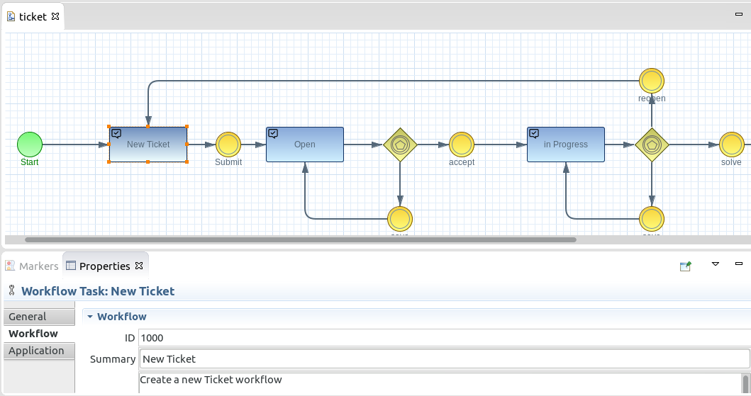
Business Workflows
Workflow in BPML, graphical notation for BPEL-enabled services
www.imixs.org

Slide 5
Scientific Workflows
Started by applying business workflow ideas to scientific problems in e-Science around 2000….
… or by automating modeling and simulation activities in the late 1990s…
… or by grad students with Bourne/BASH scripting data analysis in the late 1980s...
Not clear in the absence of a standard definition!

Slide 6
Scientific Workflows
Not clear in the absence of a standard definition!
Scientific Workflows largely split into two camps:
grid (e-Science) workflows
modeling and simulation workflows.

Slide 7
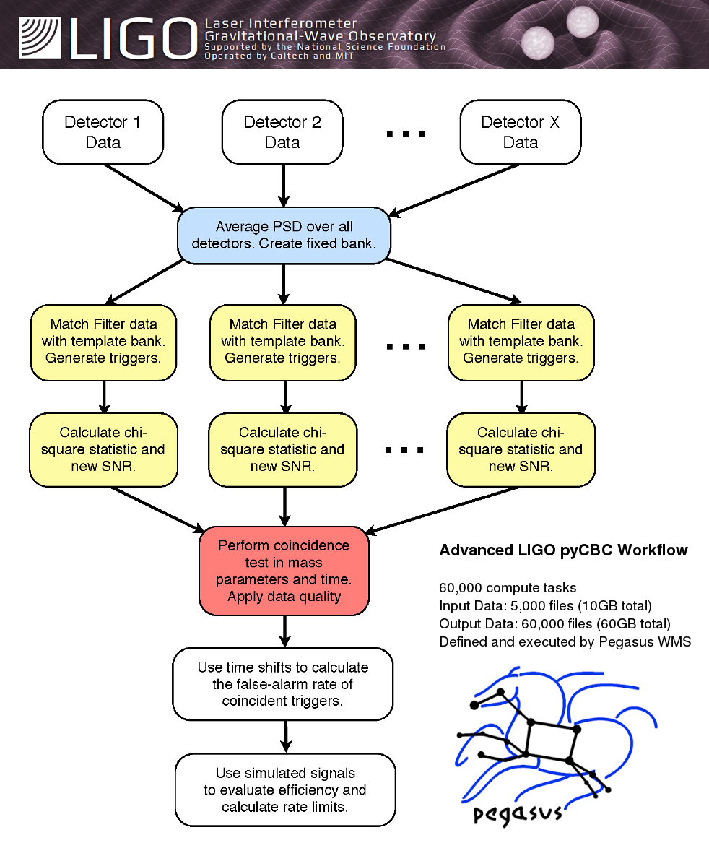
Grid Workflows
Primarily uses large grid computers for high-throughput computing.
Most workflows focus on data processing
Multiple definitions of a workflow, all “CPU-oriented” and on processes
Primary abstraction is to walk a Directed Acyclic Graph (DAG) to process a large number of input files.
Each node is a separate task
Highly optimizable
Typically short running
Typically “connected” to data acquisition (DAQ) hardware
pegasus.isi.edu

Slide 8
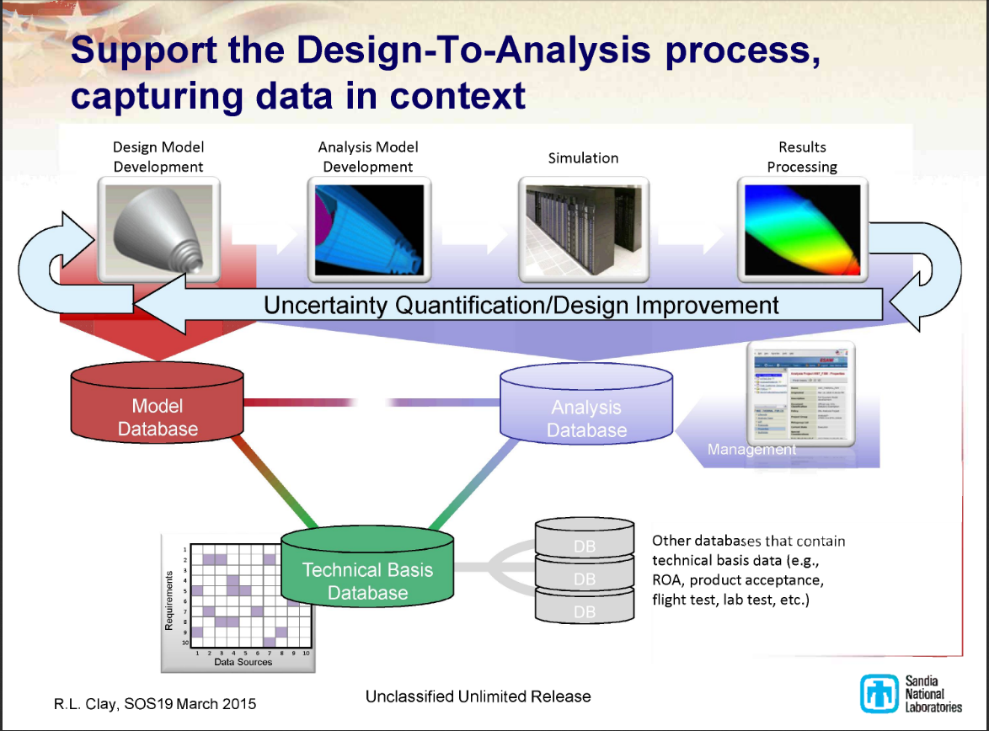
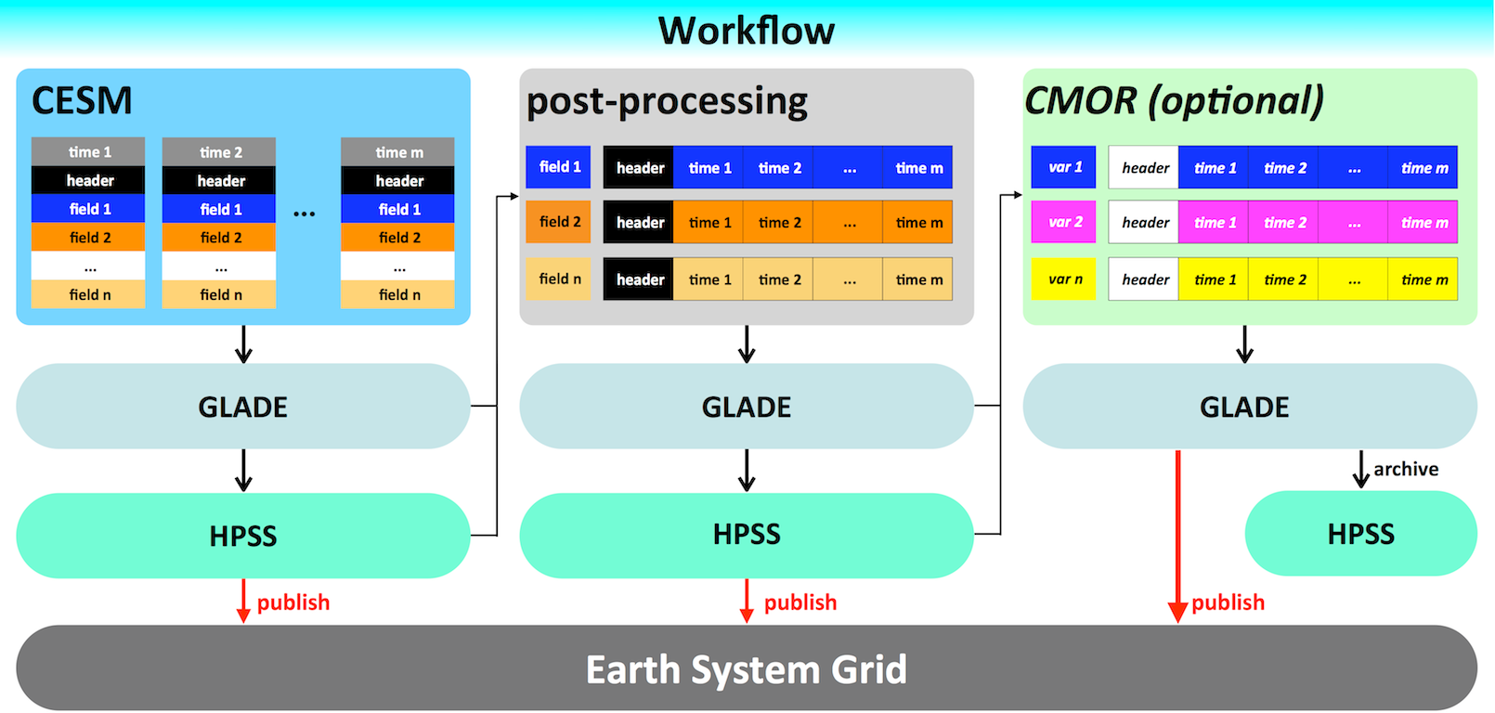
Modeling and Simulation Workflows
Primarily uses individual resources (local machines to super computers) to simulate the physical world.
Supports executing simulation frameworks that do “the heavy lifting,” - e.g., solving PDEs
Focuses on human-in-loop activities such as problem solving, analysis, monitoring
May include an “uncertainty quantification loop”
Automates all but decision making
SAW - Clay 2015
CESM - Mai 2015

Slide 9
Grid vs. M&S Workflows
There are some noticeable differences…
Grid workflows are often fully automated - starting automatically in response to generated data. M&S workflows involve people!
M&S workflows rarely connect to DAQ hardware
M&S workflows rarely explicitly expose a DAG (and don’t necessarily execute as such)
Many small jobs (grid) linked together versus one or a few large jobs (M&S)

Slide 10
Grid vs. M&S Workflows
What do they automate?
Grid workflows automate tasks like data reduction & staging. M&S workflows automate tasks like mesh generation and visualization.
Grid workflows are generally abstract and automate resource selection. M&S workflows are/do not.

Slide 11
Workflow Management Systems
Workflows are described in some “executable” way
as a standalone executable
declaratively in XML, MOML, BEPL, etc.
through code that is interpreted at runtime
A Workflow Management System (WMS) is responsible for processing workflow descriptions, which includes moving data, launching tasks, interacting with compute resources, tracking provenance, etc. to complete the workflow.
Note: Some single-use programs are process workflows, but cannot be considered to be a WMS!

Slide 12
Workflow Management Systems
Note: Some single-use programs are process workflows, but cannot be considered to be a WMS!
Theoretical reasons abound, but practically:
Does some program automate a workflow, but not “generally extensible” to other workflows? - Not a WMS!
“Generally extensible” = programmable through a public mechanism or API that doesn’t require the assistance of the original author!

Slide 13
Workflow Management Systems
Scientific WMSes are not interoperable!
Most have their own workflow description languages or extensions (different “definitions” of a workflow)
All WMSes are require customization to process a particular workflow and become domain specific
There is a natural mismatch between grid and M&S workflows by definition.

Slide 14
Workflow Management Systems
Most WMSes have the same design!
Typically MVC with appropriate extensions (n-level, MMVC, etc.)
- Extension Port
Controller
Workflow Enactment Engine
Model
Workflow Description & Data
View
Client

Slide 15
A Note on Provenance
Provenance capture is important for workflow reproducibility and well understood for all but the largest HPC workflows.
So no need to get into that....

Slide 16
The Eclipse Integrated Computational Environment
(For Example)

Slide 17



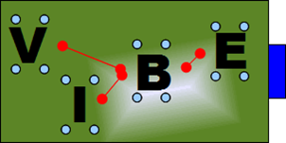

Nuclear Energy
Batteries
Quantum
Computing
Astrophysics
Welding
Binder Jet Modeling
3D Visualization
Neutron Science

Slide 18
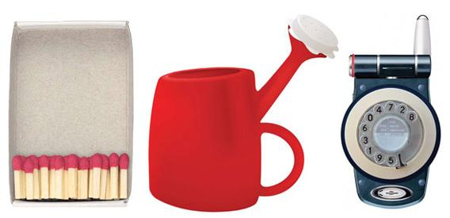
Usability

Slide 19

Usability Accessibility
How can users get access to advanced M&S capabilities?
Think of using a highly technical code as the bear trap at right:
Easily getting the good stuff requires training
Features may exist in a rusty framework with sharp edges (tough code, not always bad)
Adding something is not for the faint of heart
Making it easier to use a code naturally exposes advanced features, masks complex designs and enables users to explore!

Slide 20
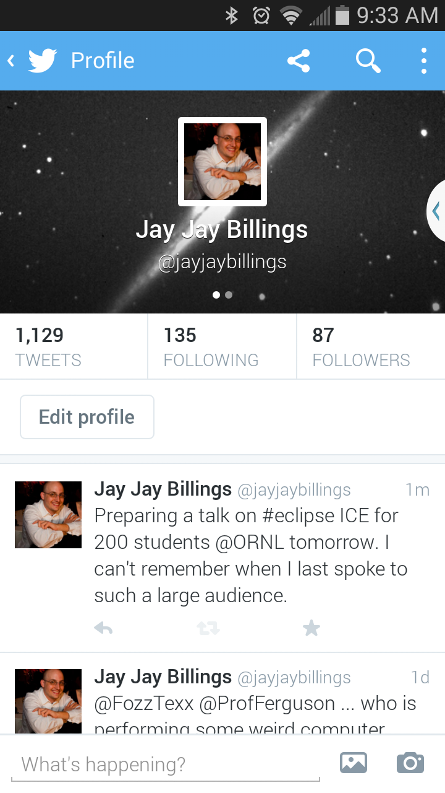
Usability in Modeling and Simulation
How I send messages around the World:
How I send messages to my code:
./xolotl ../benchmarks/he-W_2067.txt --handlers dummy --petsc -ts_final_time 1000 -ts_final_time 1000 -ts_adapt_dt_max 10 -ts_max_snes_failures 200 -pc_type fieldsplit -pc_fieldsplit_detect_coupling -fieldsplit_0_pc_type redundant -fieldsplit_1_pc_type sor -ksp_monitor -ts_max_steps 3
Really?!

Slide 21
Spectrum of Workflow Management Systems
Generality
GUIs
Ptolemy II, etc.

Slide 22
Spectrum of Workflow Management Systems
Generality
GUIs
Ptolemy II, etc.
Not Complex
Very
Complex

Slide 23
Spectrum of Workflow Management Systems
Generality
GUIs
Ptolemy II, etc.
Modeling and Simulation (ICE, SAW, etc.)
Need something in the middle that doesn’t do everything, but enables almost that much!

Slide 24
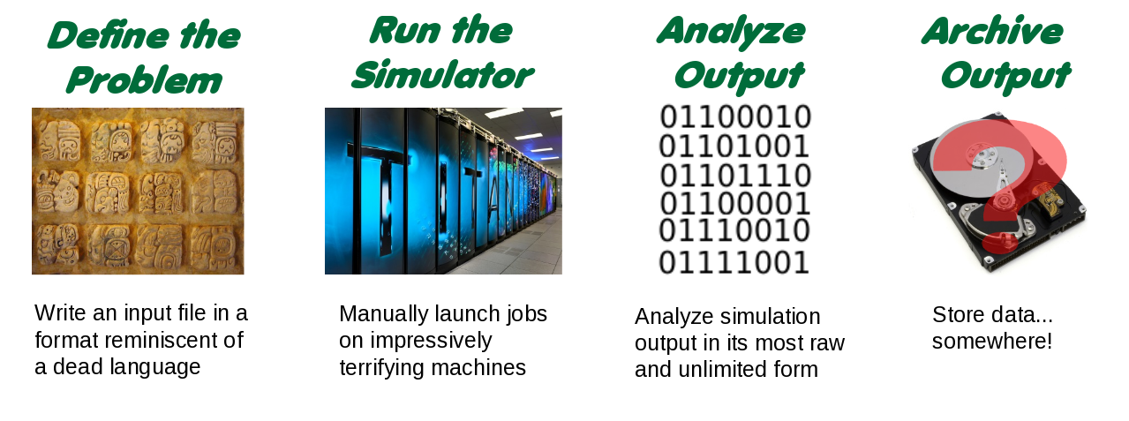
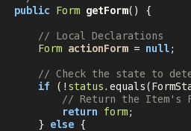
Standard Model of Scientific Computing
All users must do these things...
Development
Super-users and developers think these are easy tasks, but most users are overwhelmed!
Make it do what it do...

Slide 25
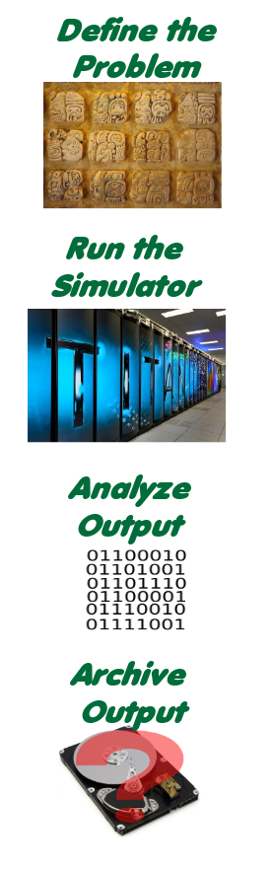

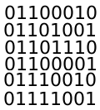
A cooler model of Scientific Computing
It would be better to have a computer program handle all of that...
A. User
Most of the stuff we need to do can be encapsulated for ease of use and/or automated entirely with improvements.
Development

Slide 26
But that doesn’t cover all M&S workflows!
It more or less does...
1
1..n
2
n+1
1
3
n+2
2
4
n+3
These are activities that are mixed and matched to produce an outcome.
Standard
Single Use
Multi-Input
“The Re-Run”

Slide 27
Project Details
100% open source, cross-platform, general-purpose environment
Primarily developed at Oak Ridge National Laboratory, but also at UTK, LBNL, L33tLabs LLC, Braithos LLC.
Focused on making life easier for users and developers
ICE does these three very well
Needs work

Slide 28
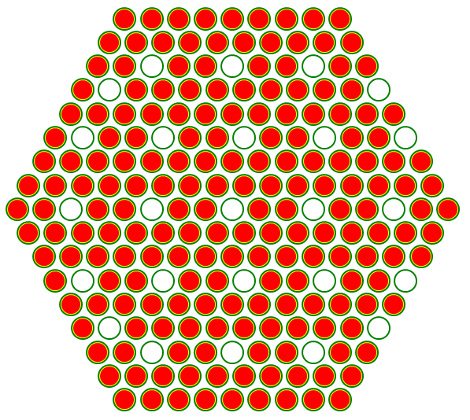
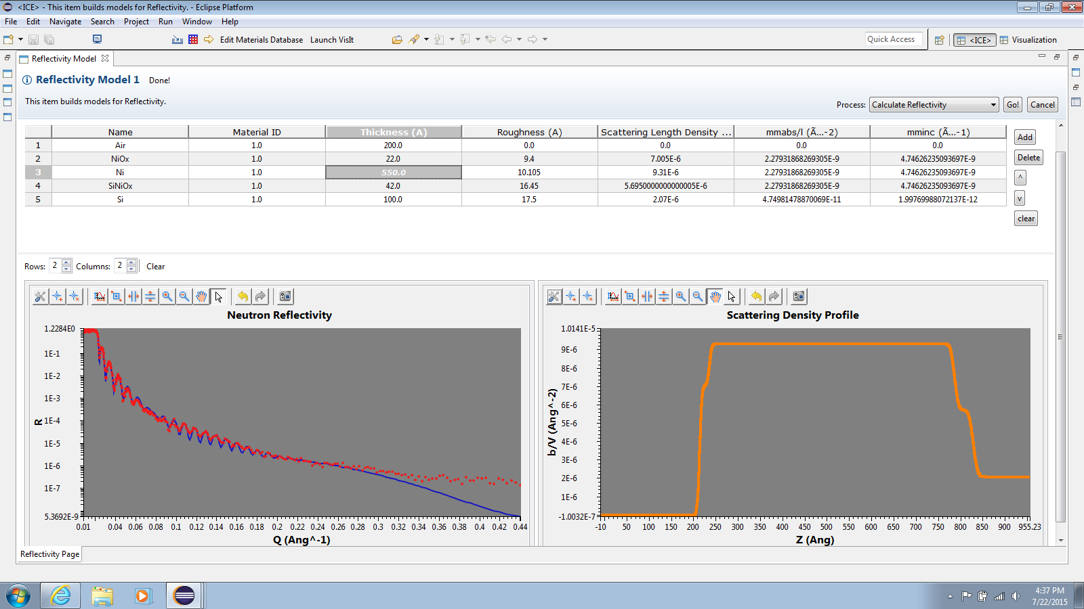
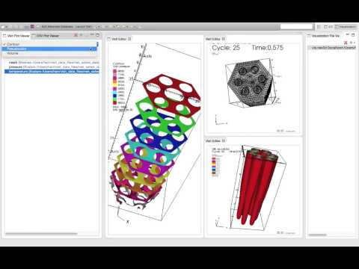
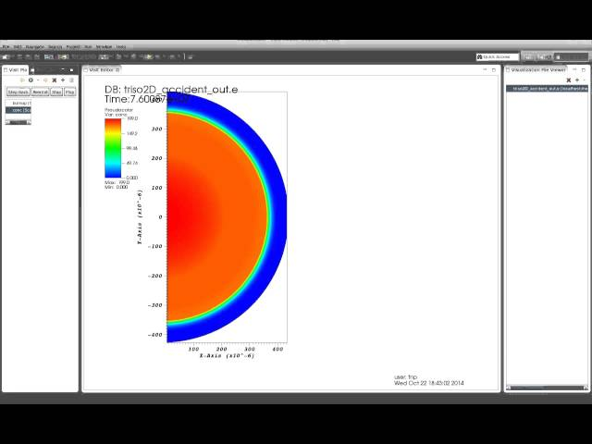
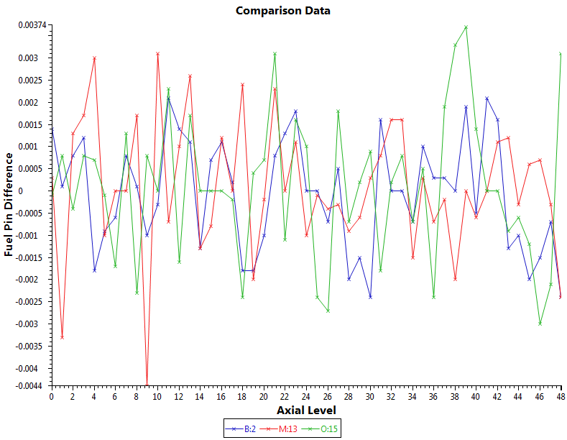
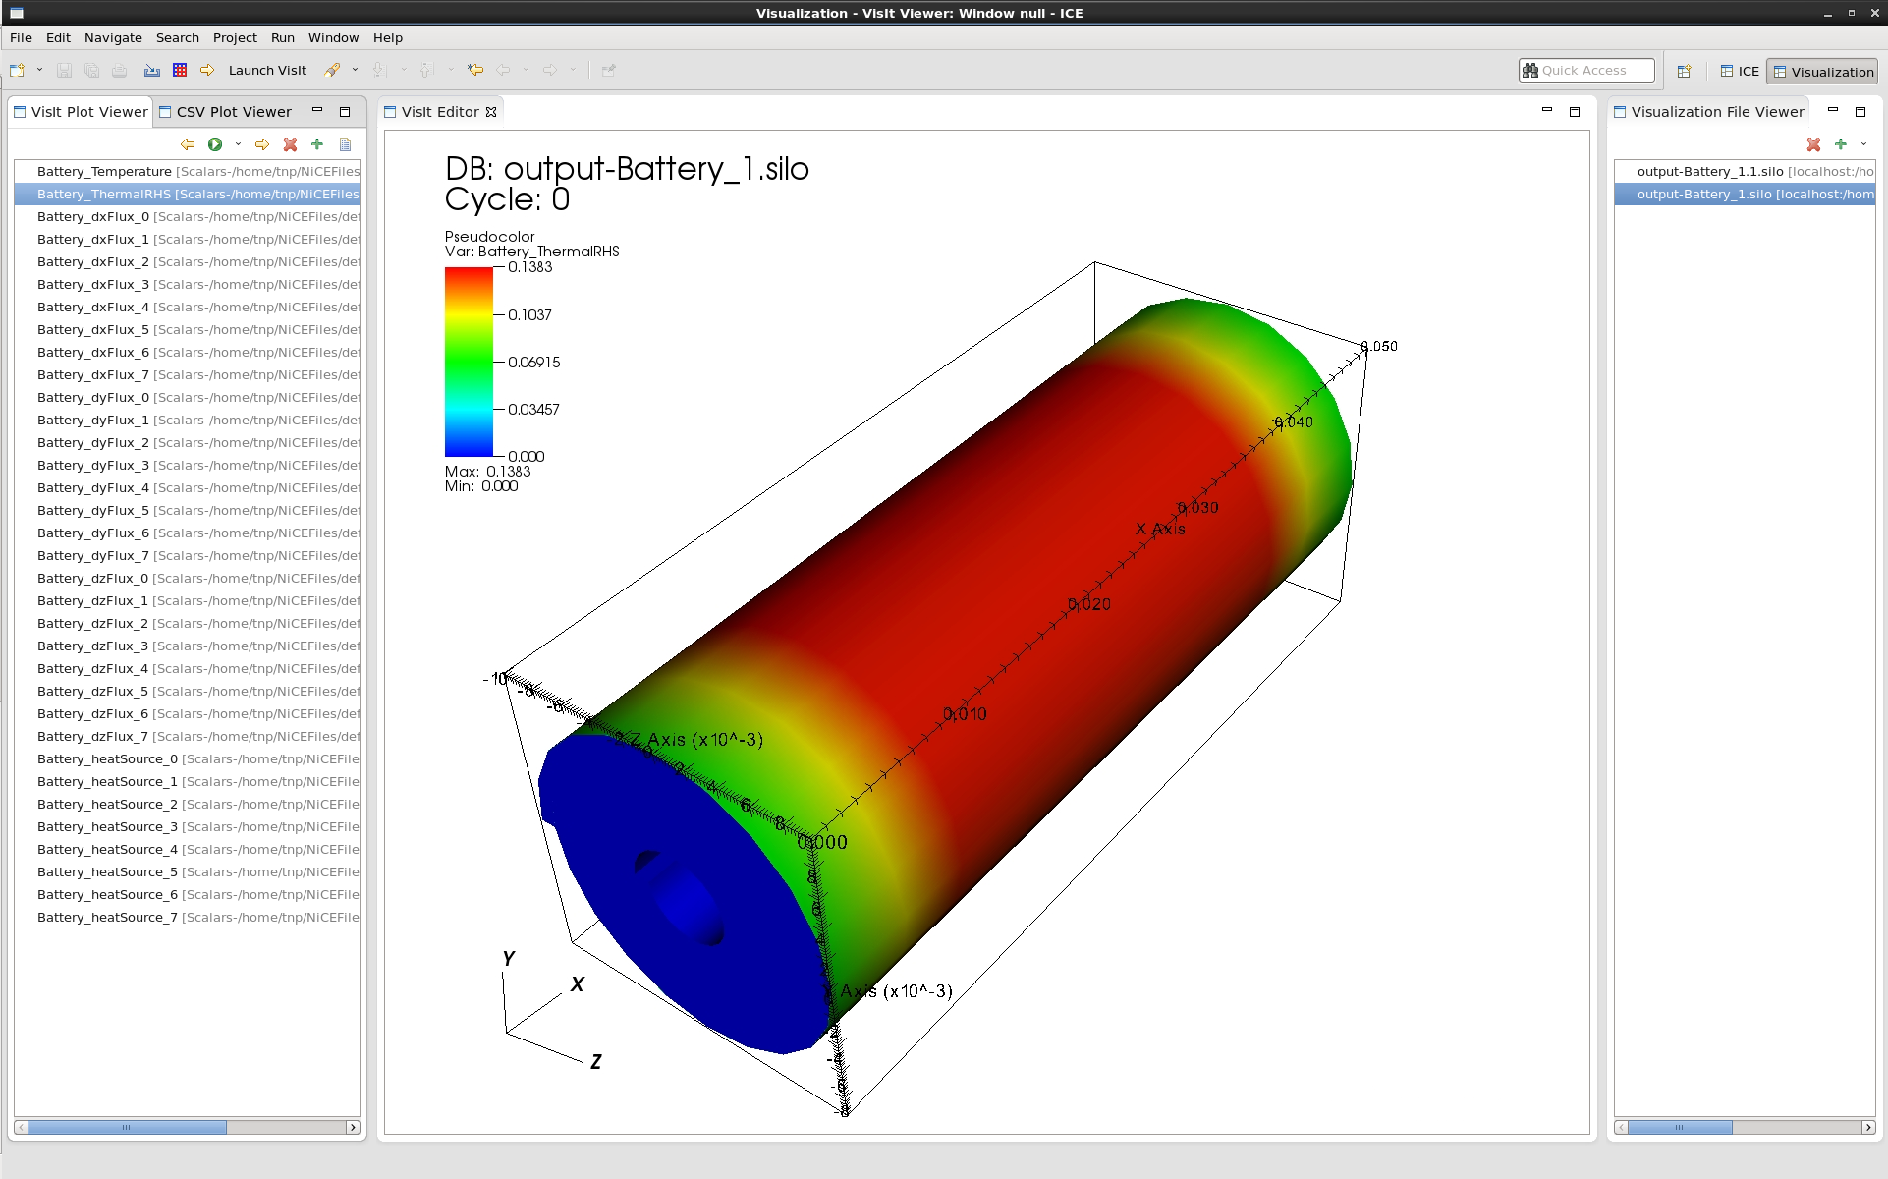
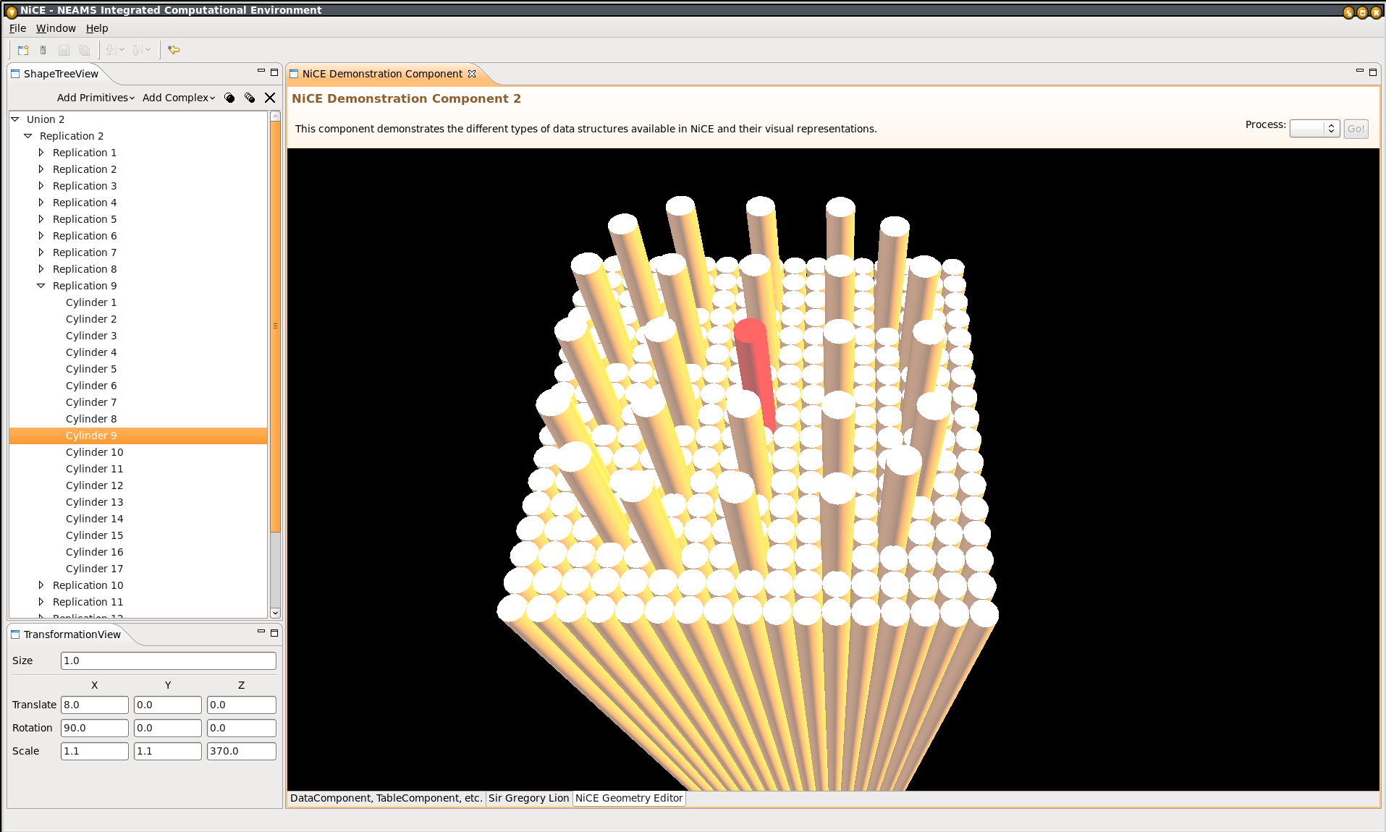
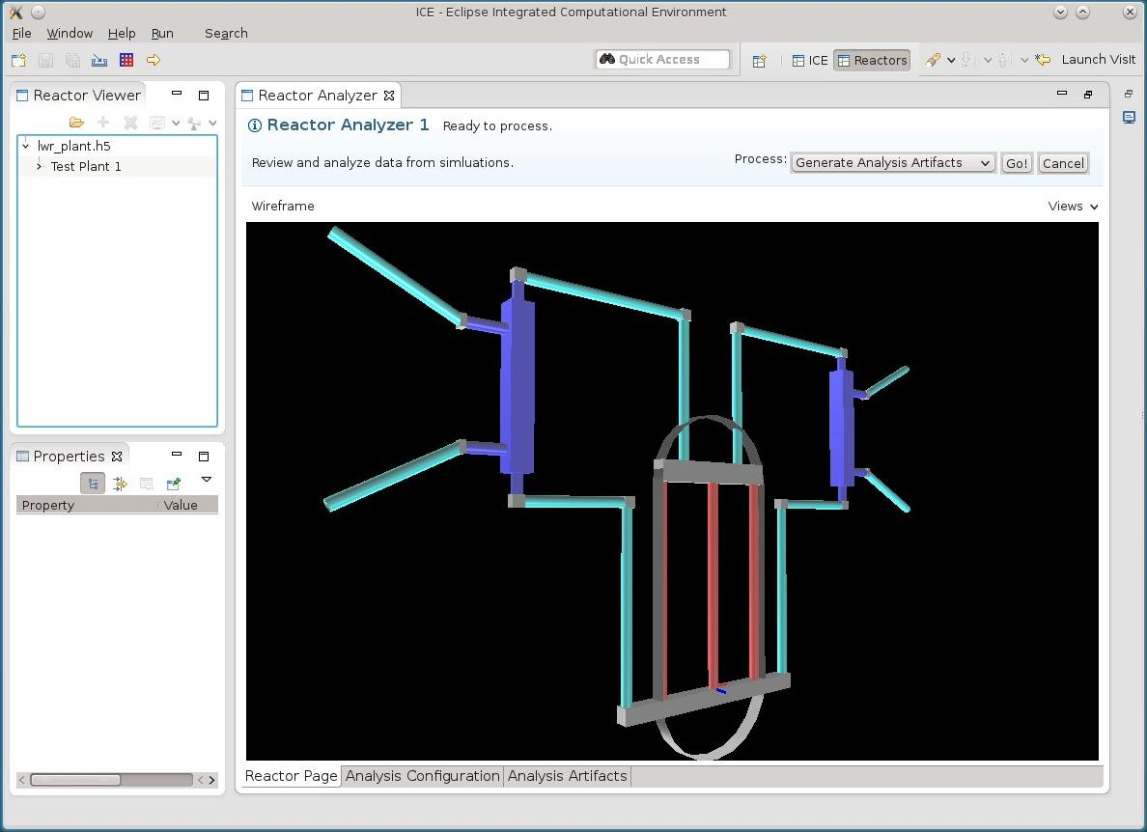
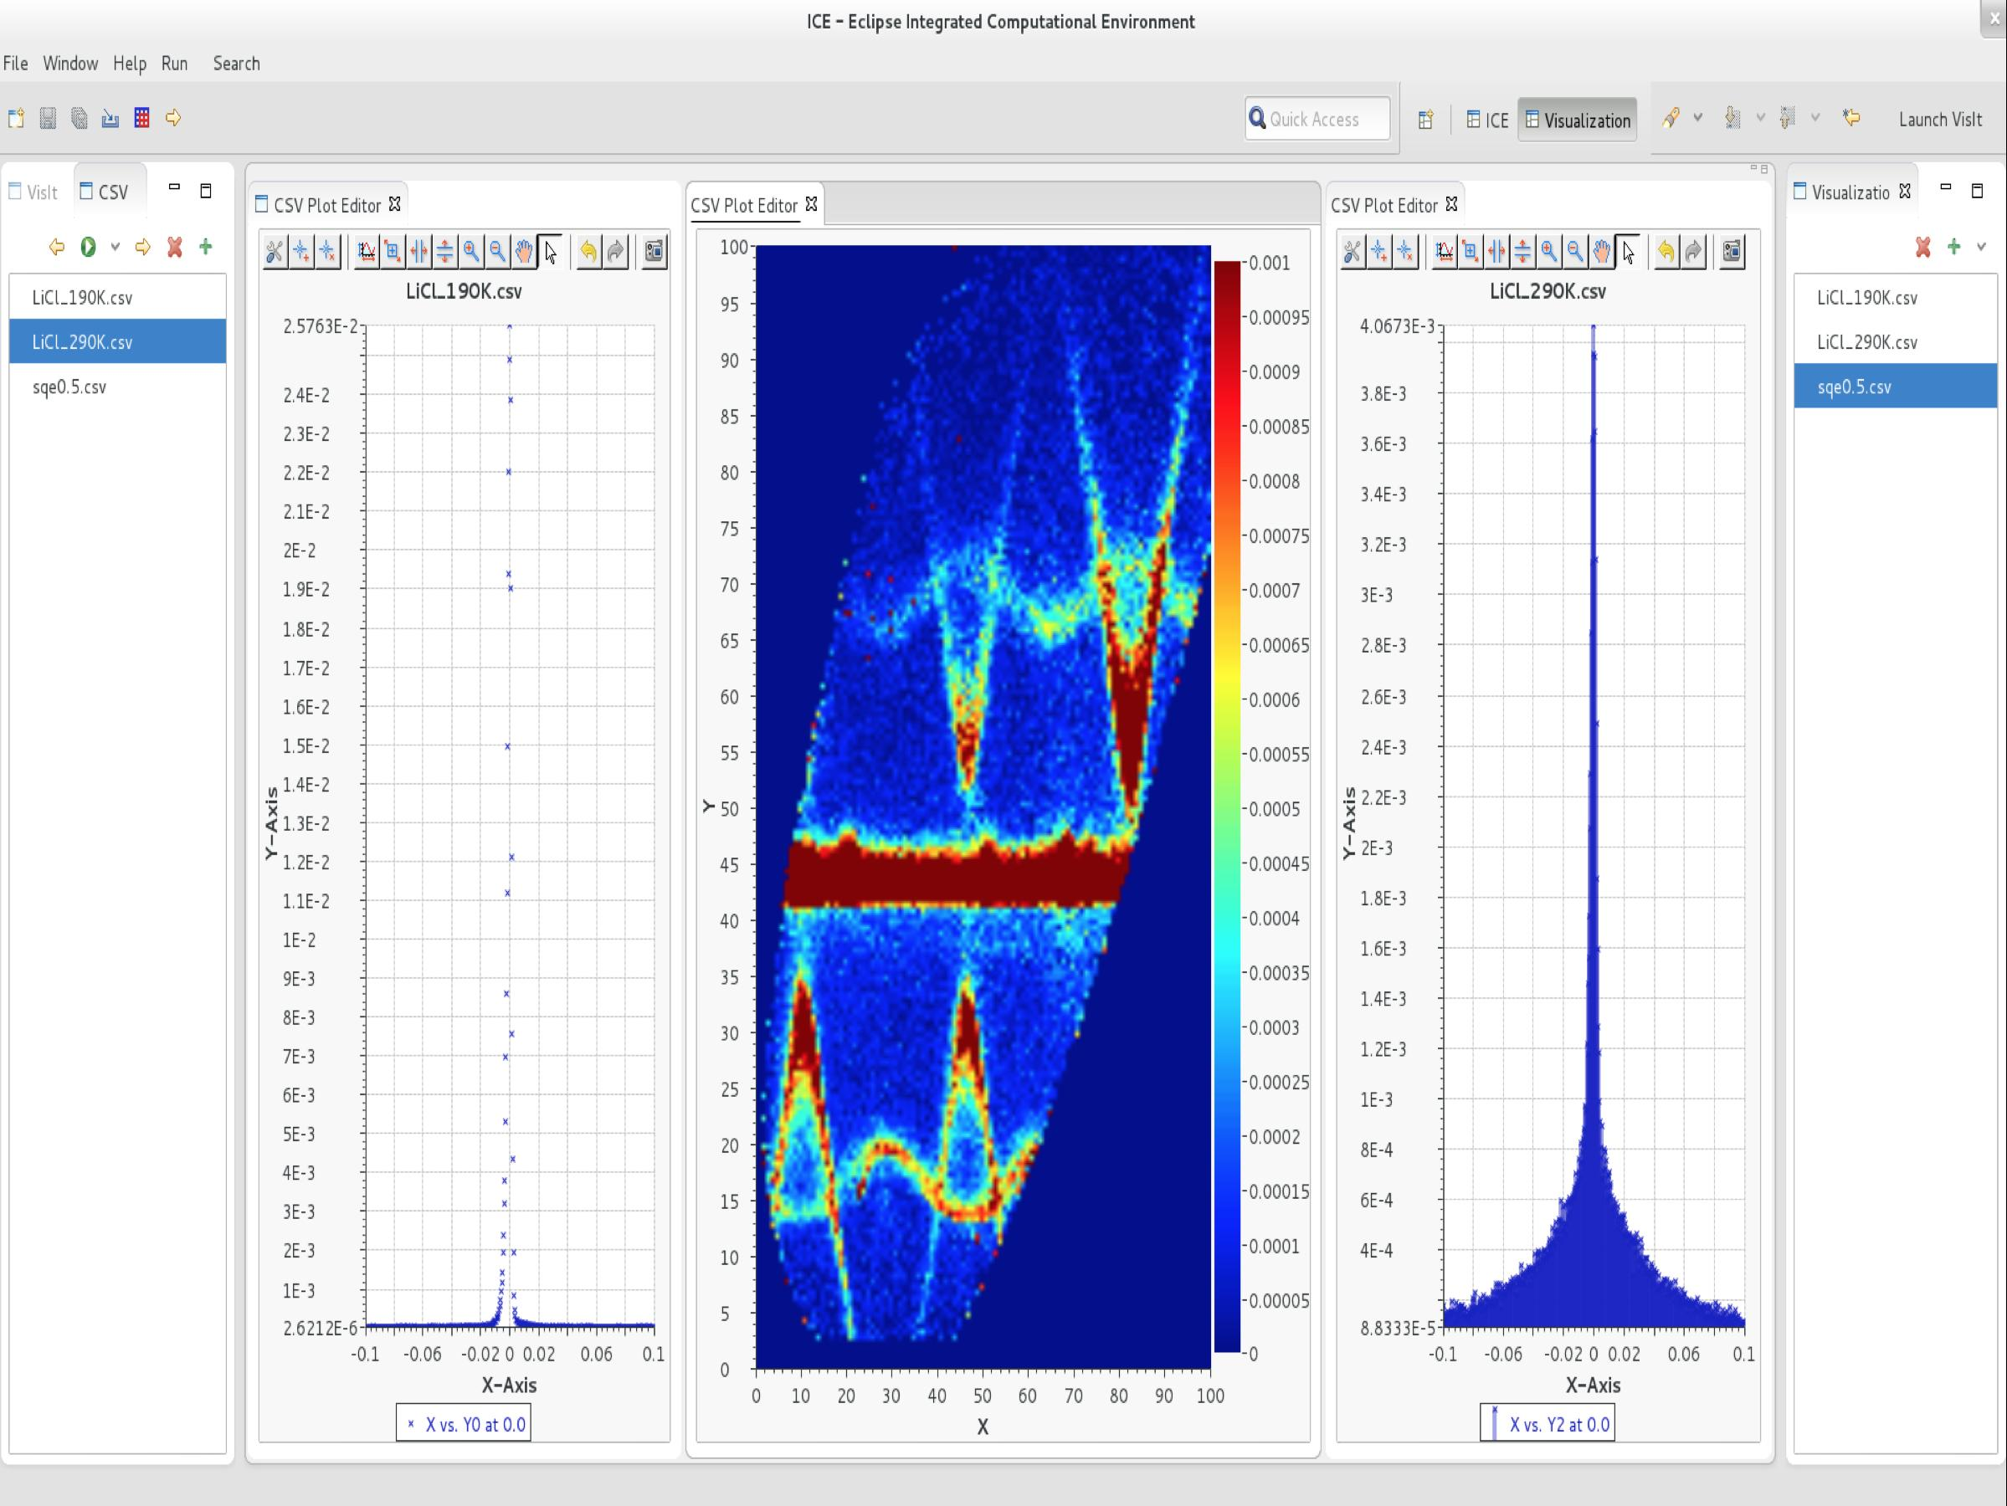
What can it do in 9 pictures or less?

Slide 29
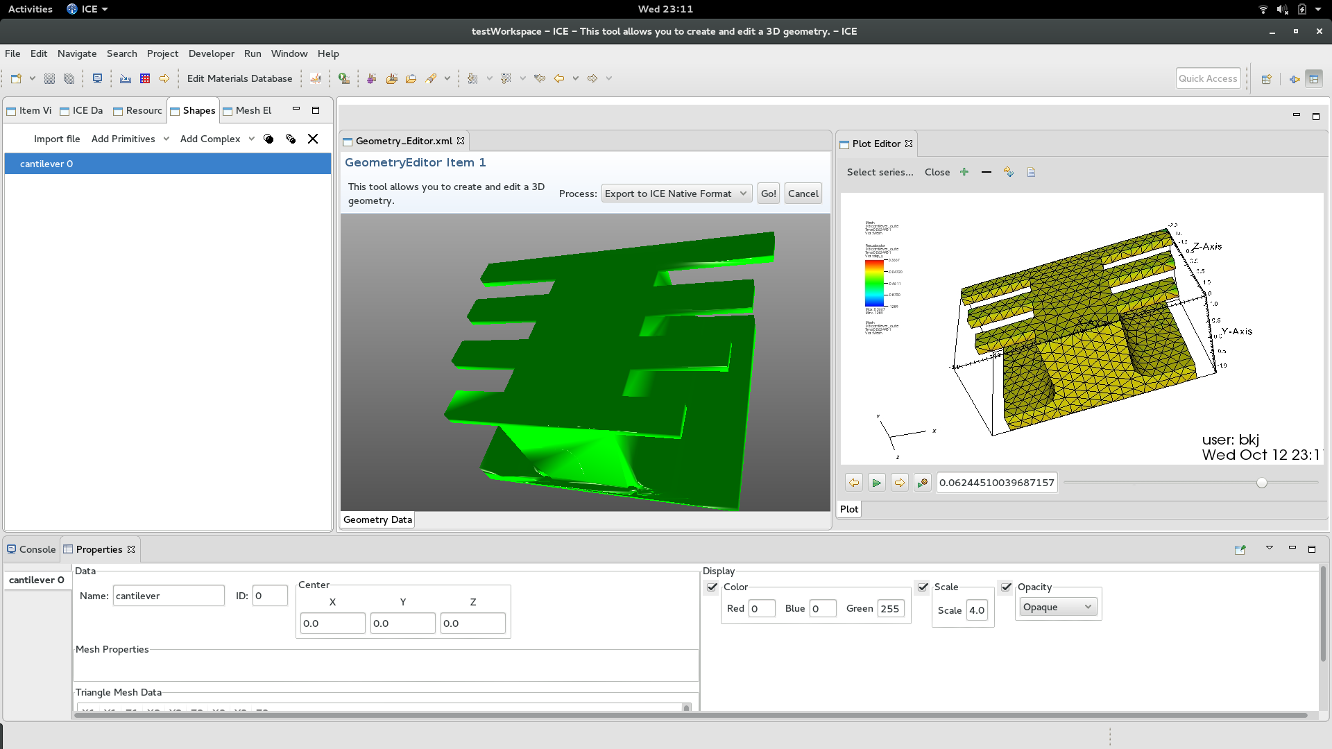
Make that 10...
Binder Jet Modeling

Slide 30
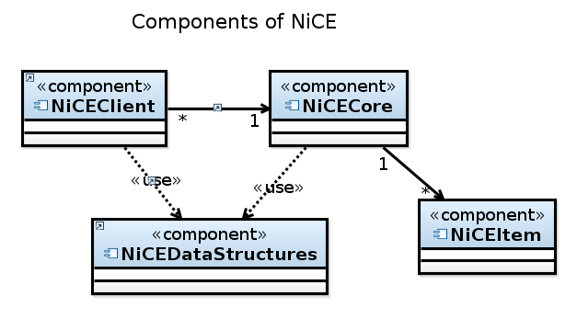
How does it work?
The platform is easily modified:
Developers write plugins
Some extensions can be made with no code (no plugins)
Plugin code goes here!
Users...
Download a binary for their OS on our website
Unzip a file to install for most capability, some dependencies for nuclear users
Follow online tutorials or join our mailing list for help
Otherwise, point and click!

Slide 31
Problems with Workflows
Notes:
Author Notes:
Mandatory standard closing slide for IBM session track presenters. Not needed for non-IBM presenters.
Additional URLs:
IBM Rational software: www.ibm.com/software/rational
Rational launch announcements: www.ibm.com/software/rational/announce/
Rational Software Delivery Platform: www.ibm.com/software/info/developer
Accelerate change and delivery: www.ibm.com/software/rational/offerings/scm.html
Deliver enduring quality: www.ibm.com/software/rational/offerings/testing.html
Enable enterprise modernization: www.ibm.com/software/info/developer/solutions/em/index.jsp
Ensure Web site security and compliance: www.ibm.com/software/rational/offerings/websecurity/
Improve project success: www.ibm.com/software/rational/offerings/lifecycle.html
Manage architecture: www.ibm.com/software/rational/offerings/design.html
Manage evolving requirements: www.ibm.com/software/rational/offerings/irm/
Small and midsized business: www.ibm.com/software/rational/smb/
Targeted solutions: www.ibm.com/software/info/developer/solutions/index.jsp
Rational trial downloads: www.ibm.com/developerworks/rational/downloads
Leading Innovation Web site: www.ibm.com/software/rational/leadership
developerWorks Rational: www.ibm.com/developerworks/rational
IBM Rational TV: www.ibm.com/software/info/television/index.jsp?cat=rational&media=video&item=en_us/rational/xml/M259765N40519Z80.xml
IBM Rational Business Partners: www.ibm.com/partnerworld/pwhome.nsf/weblook/index.html
IBM Rational Case Studies: www.ibm.com/software/success/cssdb.nsf/topstoriesFM?OpenForm&Site=rational

Slide 32
No single definition of “a workflow!”
The lack of a single definition of a workflow is a problem because of its side effects:
Interoperability - impossible because “workflow” has different meanings for different systems
Reproducibility - impossible across systems, but doable within
Sustainability - impossible because “the target keeps changing” and systems get too big

Slide 33

Monolithic
WMSes have traditionally provided system services if unavailable.
Most of these services are now available reliably and better in the system stack.
No way to replace parts of WMS code even though common “building blocks” exist.
wikipedia.org

Slide 34
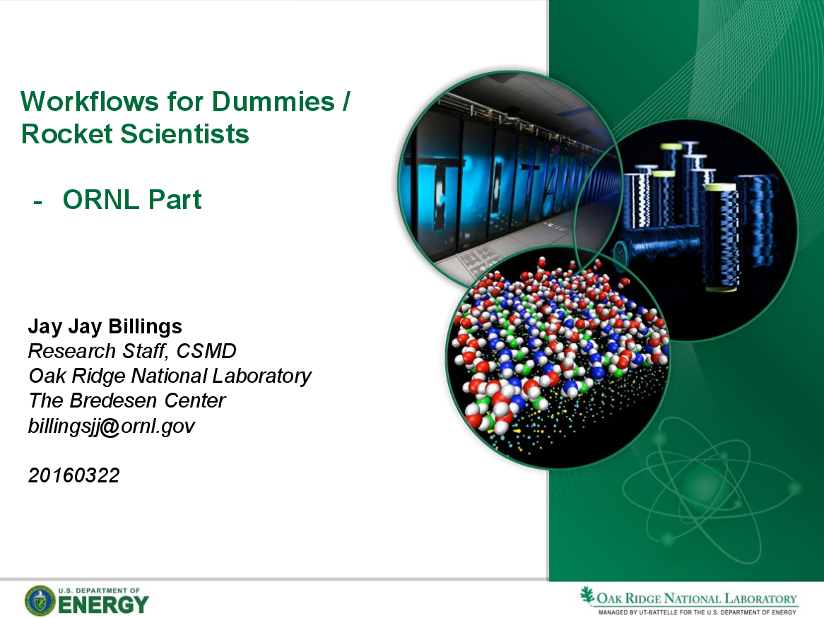
Interoperability needed for 21st century science!
21st century science requires “campaigns” of large workflows created from “chaining” smaller workflows.
OLCF - “proliferation… ...makes it difficult to choose” - must support many!
Chaining workflows means combining grid and M&S workflows!
Talk presented by the author at SOS20 that helped kick off a multi-lab workflows effort focused on interoperability.

Slide 35
Interoperability to enable reproducibility
Short-Term Reproducibility
Long-Term Reproducibility
Mostly reruns for new or current work.
Verification, higher resolution models, etc.

Slide 36
Interoperability to enable reproducibility
Long-Term Reproducibility
Verification, higher resolution models, etc.
What if hardware changes?
What if the development stops?

Slide 37
Think about this in terms of “non-general” systems
SAW - Clay 2015
CESM - Mai 2015

Slide 38
Proposal Part 1: Deriving Higher Order Concepts

Slide 39
Higher Order Concepts
Are there higher order concepts to understand about workflows and workflow management systems?
Open questions:
Are business and science workflows the same or different? (i.e. - can they be uniformly standardized)
What really separates grid workflows from M&S workflows?
What are the common building blocks?

Slide 40
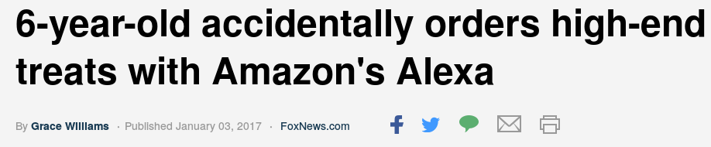

Workflows are about automation...
For example, for cookies or nuclear data analysis:
Known, desirable goal
Known, repetitive tasks required to achieve the goal
Standardized ways of consuming results

Slide 41
Workflows are about automation...
But only ever discussed in terms of what they automate!

Slide 42
What are the innate characteristics of the automation?
For example, for cookies or nuclear data analysis:
Known, desirable goal
Known, repetitive tasks required to achieve the goal
Standardized ways of consuming results

Slide 43
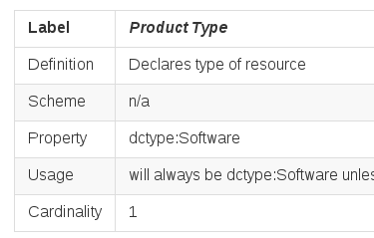
Need an ontology
Create models of workflows, WMSes, and data that reveal these higher order concepts.
Will expose common features, stark differences between workflow models
Create a map from this ontology to common ontologies
“Models?”
UML Models
Metadata Models

Slide 44
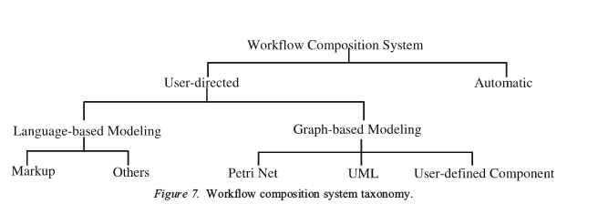
Why not a taxonomy?
The rigid hierarchy of a taxonomy can “lock” it against extension.
For example, where does a language that allows users to manipulate the graph fit? Aren’t some automatic workflows graph based?
From Yu and Buyya’s 2005 Grid Workflow Taxonomy

Slide 45
Why not a taxonomy?
For example, where does a language that allows users to manipulate the graph fit? Aren’t some automatic workflows graph based?
So move away from labeled DAGS (taxonomy trees) to fully unstructured graphs (ontologies)!

Slide 46
Proposal Parts 2 - 4: Describe and Develop Interoperability Layer

Slide 47
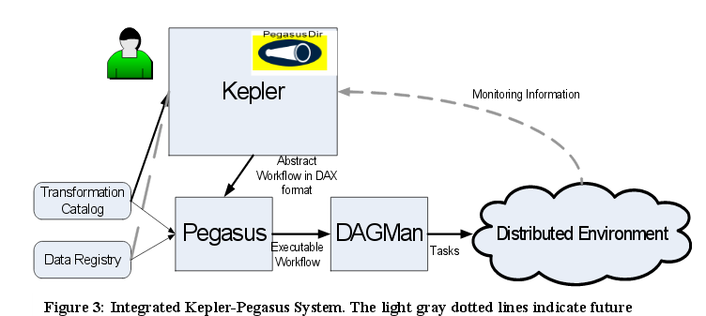
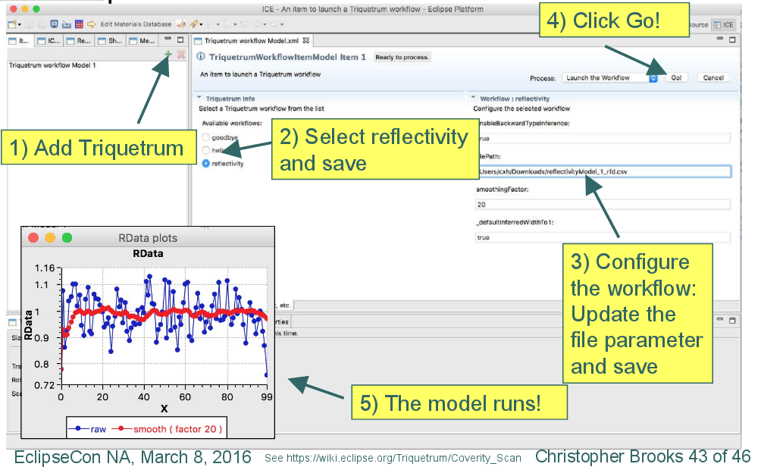
Previous Interoperability Attempts
Some prior art exists for WMS interoperability.
Mandel et al. integrated Kepler & Pegasus.
Brooks et al. integrated Triquetrum & ICE.
But!- Both were hardwired, and purely for demonstrational purposes.

Slide 48
Types of Interoperability
A detailed ontology exposes levels and types of interoperability!
Call other WMS (both previous examples)
Natively execute
Translate/transcode descriptions completely, e.g. - with XSLT
Map descriptions using data integration tools like Karma

Slide 49
Use ICE as a development incubator
ICE has unique properties that favor it as an incubator for the interoperability layer:
“Done it before”
Standard API
Generates most of its own extension code
Workflows based on standard languages (Java and Python)
Already wired for web service infrastructure
Successfully incubated two other projects

Slide 50
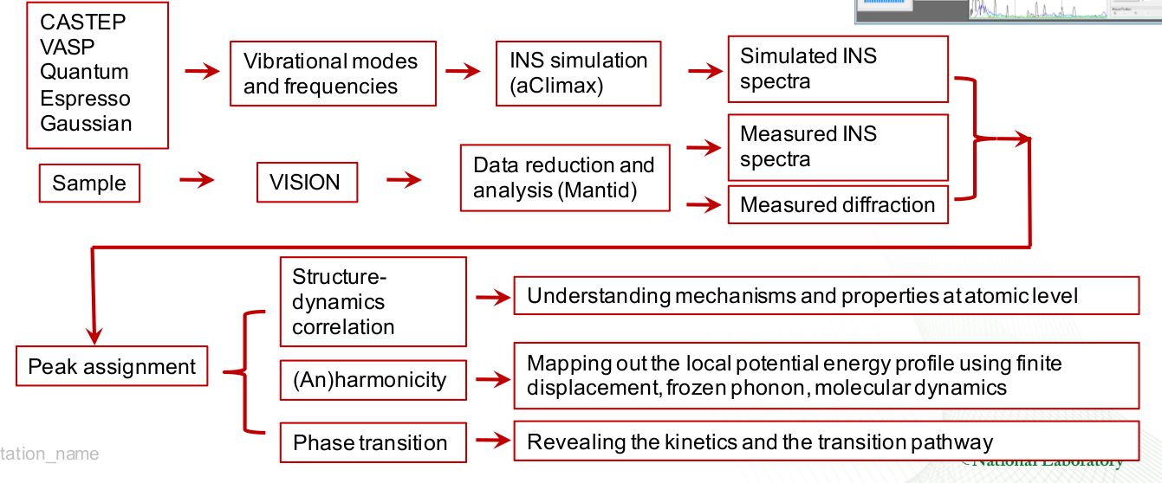
Interoperability Enables Workflow Campaigns
ORNL’s ICEMAN project exposes such a campaign for neutron science!
ORNL ICEMAN Proposal
Requires multiple WMSes!

Slide 51
Interoperability Enables Workflow Campaigns
Grid workflow engine
AiiDA+ICE
ORNL ICEMAN Proposal
ICE

Slide 52
Other relevant areas
Additive Manufacturing - Many codes, much data analysis, lots of “automatable” knowledge
Quantum Computing - Soon there will be many different hardware types hybridized with traditional HPC systems
(And obviously other areas where ICE has been deployed.)

Slide 53
Wrap Up
Notes:
Author Notes:
Mandatory standard closing slide for IBM session track presenters. Not needed for non-IBM presenters.
Additional URLs:
IBM Rational software: www.ibm.com/software/rational
Rational launch announcements: www.ibm.com/software/rational/announce/
Rational Software Delivery Platform: www.ibm.com/software/info/developer
Accelerate change and delivery: www.ibm.com/software/rational/offerings/scm.html
Deliver enduring quality: www.ibm.com/software/rational/offerings/testing.html
Enable enterprise modernization: www.ibm.com/software/info/developer/solutions/em/index.jsp
Ensure Web site security and compliance: www.ibm.com/software/rational/offerings/websecurity/
Improve project success: www.ibm.com/software/rational/offerings/lifecycle.html
Manage architecture: www.ibm.com/software/rational/offerings/design.html
Manage evolving requirements: www.ibm.com/software/rational/offerings/irm/
Small and midsized business: www.ibm.com/software/rational/smb/
Targeted solutions: www.ibm.com/software/info/developer/solutions/index.jsp
Rational trial downloads: www.ibm.com/developerworks/rational/downloads
Leading Innovation Web site: www.ibm.com/software/rational/leadership
developerWorks Rational: www.ibm.com/developerworks/rational
IBM Rational TV: www.ibm.com/software/info/television/index.jsp?cat=rational&media=video&item=en_us/rational/xml/M259765N40519Z80.xml
IBM Rational Business Partners: www.ibm.com/partnerworld/pwhome.nsf/weblook/index.html
IBM Rational Case Studies: www.ibm.com/software/success/cssdb.nsf/topstoriesFM?OpenForm&Site=rational

Slide 54
Summary
There is no common understanding of workflows, which has the serious side effect of preventing a general means of interoperability.
This work proposes:
To develop a comprehensive ontology of workflows
To develop and provide an interoperability layer for workflows based on the ontology
To provide the interoperability layer as a common building block available through a web service
To demonstrate the utility using one or more energy science projects at ORNL that have workflow needs (ICEMAN in particular)

Slide 55
Preemptively Answering Some Questions
Notes:
Author Notes:
Mandatory standard closing slide for IBM session track presenters. Not needed for non-IBM presenters.
Additional URLs:
IBM Rational software: www.ibm.com/software/rational
Rational launch announcements: www.ibm.com/software/rational/announce/
Rational Software Delivery Platform: www.ibm.com/software/info/developer
Accelerate change and delivery: www.ibm.com/software/rational/offerings/scm.html
Deliver enduring quality: www.ibm.com/software/rational/offerings/testing.html
Enable enterprise modernization: www.ibm.com/software/info/developer/solutions/em/index.jsp
Ensure Web site security and compliance: www.ibm.com/software/rational/offerings/websecurity/
Improve project success: www.ibm.com/software/rational/offerings/lifecycle.html
Manage architecture: www.ibm.com/software/rational/offerings/design.html
Manage evolving requirements: www.ibm.com/software/rational/offerings/irm/
Small and midsized business: www.ibm.com/software/rational/smb/
Targeted solutions: www.ibm.com/software/info/developer/solutions/index.jsp
Rational trial downloads: www.ibm.com/developerworks/rational/downloads
Leading Innovation Web site: www.ibm.com/software/rational/leadership
developerWorks Rational: www.ibm.com/developerworks/rational
IBM Rational TV: www.ibm.com/software/info/television/index.jsp?cat=rational&media=video&item=en_us/rational/xml/M259765N40519Z80.xml
IBM Rational Business Partners: www.ibm.com/partnerworld/pwhome.nsf/weblook/index.html
IBM Rational Case Studies: www.ibm.com/software/success/cssdb.nsf/topstoriesFM?OpenForm&Site=rational

Slide 56
Why is this a PhD?
It pushes the bounds of what we know, not solely because it needs to be done, but because what lies beyond is interesting!
That is…
A strict search of the literature found little work in either workflow ontologies or workflow interoperability.
Although the community has called for it, little work is proceeding in this direction.
It has the opportunity to greatly affect “downstream” project, particularly interdisciplinary projects.

Slide 57
Why is an astrophysicist doing this?
Because it doesn’t matter who does it, only that it gets done.

Slide 58
What is the research done to date?
Nearly 9 years building this “instrument!”
Addressed a lot of workflow problems
Capable of incubating an interoperability layer
Highly publishable

Slide 59
Publication Plan?
Immediate:
Comprehensive exam Chapter 3 on ICE in review, Software X (Elsevier) journal submission imminent
Exam chapters 2 & 4 going into Jan. 23rd PASC17 submission
6-months:
“Workflow Ontology” paper
Practical papers on interoperability layer and its use in ICEMAN for neutrons

Slide 60
Any Questions?
Notes:
Author Notes:
Mandatory standard closing slide for IBM session track presenters. Not needed for non-IBM presenters.
Additional URLs:
IBM Rational software: www.ibm.com/software/rational
Rational launch announcements: www.ibm.com/software/rational/announce/
Rational Software Delivery Platform: www.ibm.com/software/info/developer
Accelerate change and delivery: www.ibm.com/software/rational/offerings/scm.html
Deliver enduring quality: www.ibm.com/software/rational/offerings/testing.html
Enable enterprise modernization: www.ibm.com/software/info/developer/solutions/em/index.jsp
Ensure Web site security and compliance: www.ibm.com/software/rational/offerings/websecurity/
Improve project success: www.ibm.com/software/rational/offerings/lifecycle.html
Manage architecture: www.ibm.com/software/rational/offerings/design.html
Manage evolving requirements: www.ibm.com/software/rational/offerings/irm/
Small and midsized business: www.ibm.com/software/rational/smb/
Targeted solutions: www.ibm.com/software/info/developer/solutions/index.jsp
Rational trial downloads: www.ibm.com/developerworks/rational/downloads
Leading Innovation Web site: www.ibm.com/software/rational/leadership
developerWorks Rational: www.ibm.com/developerworks/rational
IBM Rational TV: www.ibm.com/software/info/television/index.jsp?cat=rational&media=video&item=en_us/rational/xml/M259765N40519Z80.xml
IBM Rational Business Partners: www.ibm.com/partnerworld/pwhome.nsf/weblook/index.html
IBM Rational Case Studies: www.ibm.com/software/success/cssdb.nsf/topstoriesFM?OpenForm&Site=rational

Slide 61
Next Version - ICE “Mark III”
Breaking into smaller, scalable pieces because the future…
… is user interaction on the web …
… is a provenance model that includes instructions capture …
… is “workflow aggregation” across workflow engines …
… will be multi-institutional “workflow campaigns” of problems ...

Slide 62
The Eclipse Foundation
The Eclipse Foundation is...
a community for developing commercially-friendly open source software
responsible for developing the massive Eclipse Platform
a nonprofit, member supported organization
currently hosting over 250 projects (NiCE was #251!)
a “main line” into collaborations with high-profile organizations
blessed with nine million users worldwide
essentially the NFL of software development
But what does it all mean for ORNL? Why did we do this?

Slide 63
The Eclipse Foundation, p2
Lots of value for ORNL:
License issues checked and code released under industry friendly license
Rigorous software development community helps improve our tech
Common build infrastructure, etc.
ICE is exposed to a very large number of users at conferences, in articles, and as part of releases.
Streamlines contributions coming *BACK* to ICE
Contribution under CLA (GitHub, Bugzilla, email)
Eclipse Review
(License, Origin, Relevance)
Integration into project
How we now take contributions...

Slide 64
Collaboration Outlook
Core Developers
ORNL
LBNL
UTK
Subject Matter Experts
ANL
INL
UT-Dallas
Contributors
Diamond Light Source
Duquesne University
Hopeful Future Contributors
DOE IT
Kitware Inc.
The NiCE team is multi-institutional and growing!
Our goal is to foster an open, collaborative community that includes contributions of all forms from everyone and encourages constructive, positive discourse about and the implementation of highly usable open source modeling and simulation tools with an license that supports wide adoption of the platform.
We hope to double the number of core developers and core developer institutions in the next calendar year.

Slide 65
Collaboration Opportunities
We want YOU to join our team!
Our goal is to foster an open, collaborative community that includes contributions of all forms from everyone and encourages constructive, positive discourse about and the implementation of highly usable open source modeling and simulation tools with an license that supports wide adoption of the platform.
Many ways to collaborate:
Use ICE
Test ICE
Give us some code
Give us something to code
Provide feedback
Develop documentation
Tell your friends about us
Introduce us to some new technologies
Also, we have a small amount of funding available to support good ideas or interesting work.

Slide 66
Getting Started as a User
https://wiki.eclipse.org/ICE
Join the user mailing list! - https://dev.eclipse.org/mailman/listinfo/ice-users
Download ICE - http://sourceforge.net/projects/niceproject/files/nightly/nice/
Check out our wiki - http://sourceforge.net/p/niceproject/docs/Main%20Page/
Email the list if you have questions!
Getting Started with Development
Join the dev mailing list! - https://dev.eclipse.org/mailman/listinfo/ice-dev
Download Eclipse - http://www.eclipse.org/downloads/
Setup your environment - http://wiki.eclipse.org/ICE_Build_Instructions
Start playing with org.eclipse.ice.tablecomponenttester
Email the list if you have questions!

